Slide 1
Assignment on Bayes’ Decision Rule

Slide 2
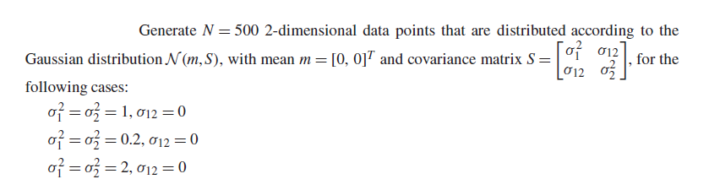
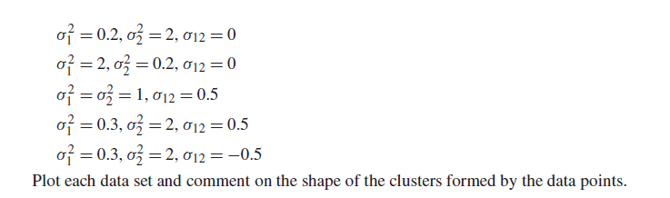
Example

Slide 3
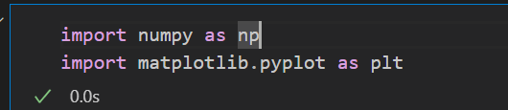
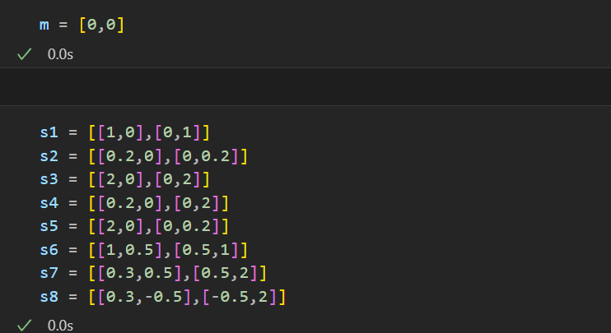
Solution
Import necessary libraries:
Assign Mean and Covariance Matrix according to the given values:

Slide 4
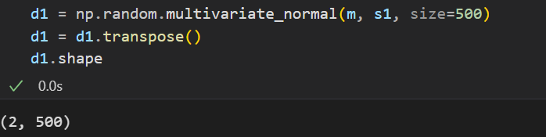
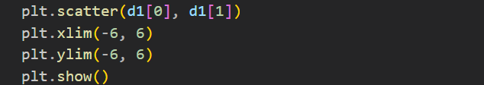
Solution (cont.)
Generate 500 2d data points according to the gaussian distribution :
Plot the data:
Xlim() and ylim() is used to create the range of the x and y axis respectively.
Use the same code and change mean m and covariance matrix s1 in multivariate_normal function to complete the rest.

Slide 5
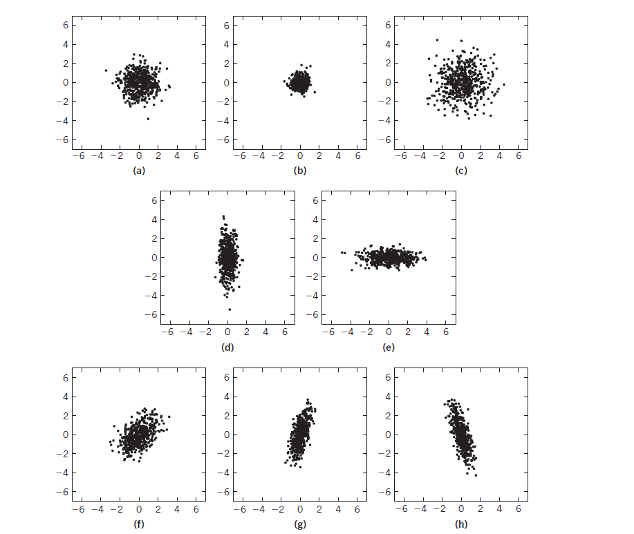
Expected Outcome

Slide 6
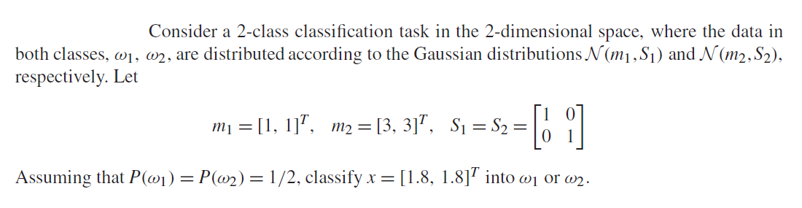
Assignment 1
The resulting values for p1 and p2 are 0.042 and 0.0189, respectively, and x is classified to ω1 according
to the Bayesian classifier.

Slide 7
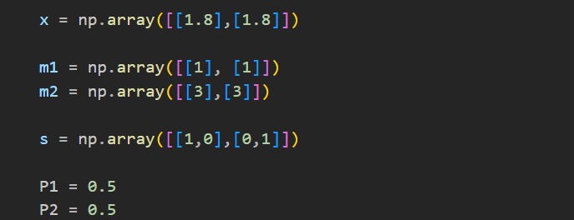
Solution
Import necessary libraries:
Initialize all the given values :

Slide 8
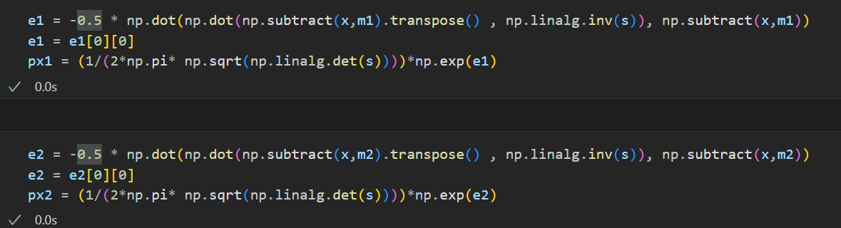
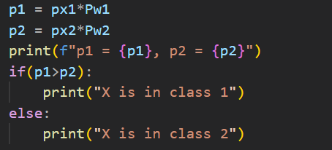
Solution (cont.)
Find the gaussian pdf value for class 1 and 2:
Find p1 and p2 and classify:

